Slide 1

IEEE 754 Converter
Koteswar Meesala
Neha Jain
Neha Singh
Yaswanth Reddy

Slide 2
Project Assignment
Create an application tool for a user to handle IEEE 754 floating point numbers (Refer to the specification from 1985 and the Project PPT shown in class).
A. The app should convert a decimal (single precision 32bit floating point) number so it can display all the following:
1. Decimal
2. Sign Exponent Mantissa display of (binary) bits
3. Hexadecimal display
B. The app should be a simple calculator that allows it to operate on two input numbers and generate a correct result with the following operators:
1. Addition, 2. Subtraction, 3. Multiplication
C. The app should be able to display the input values and the result in all three display formats listed in A. above.
D. The app should be able to identify the following characteristic of inputs and result as follows:
1. Normalized Floating-Point Number
2. Denormalized Floating Point Number
3. Not a number (NaN)
4. Zero

Slide 3
Tech stack
React
JavaScript
Python
HTML
CSS
Application setup can be found in the below word document.

Slide 4

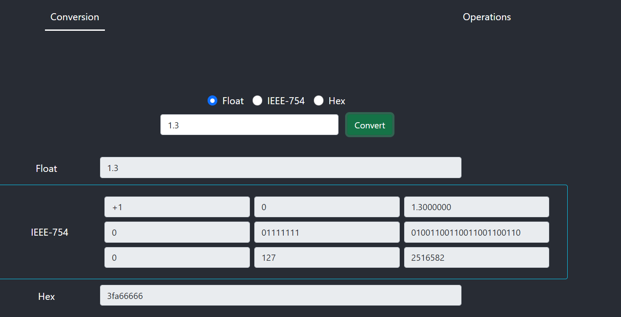

Slide 5
Conversion
The conversion page is to convert the input value entered by the user into all the three formats.
User selects the format and then enters a valid value in the format selected and clicks on convert button.
For IEEE 754 conversion, user is shown three fields to enter sign, exponent(unbiased) and mantissa.
The results are then displayed in all the three formats.
The IEEE-754 result is shown in binary representation(32 bits) along with the decimal conversion of sign, exponent mantissa bits.

Slide 6
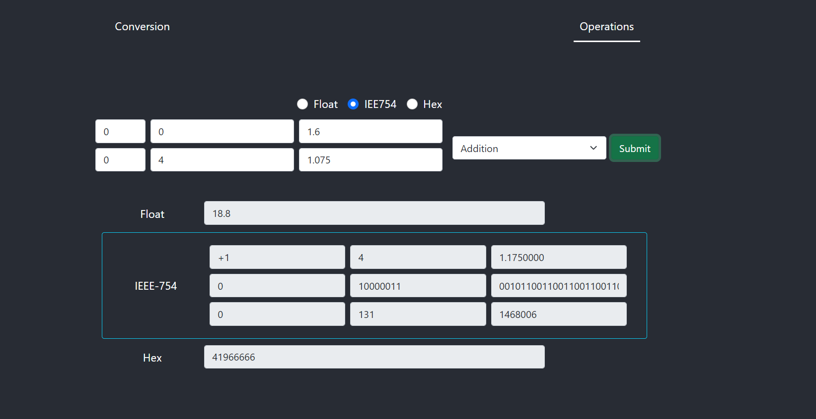

Slide 7
Operations
The operations page is to perform an operation on the input values entered by the user and display the result in all the three formats.
User selects the format, enters valid values acc. to the format selected, selects the operation, and clicks on submit button.
For IEEE 754 conversion, user is shown three fields to enter sign, exponent(unbiased) and mantissa.
The results are then displayed in all the three formats.
The IEEE-754 result is shown in binary representation(32 bits) along with the decimal conversion of sign, exponent mantissa bits.

Slide 8
Thank you☺

